Slide 1
Data at Scale
Sara Muneeb
sara.muneeb@cuilahore.edu.pk
Computer Science Department

Slide 2
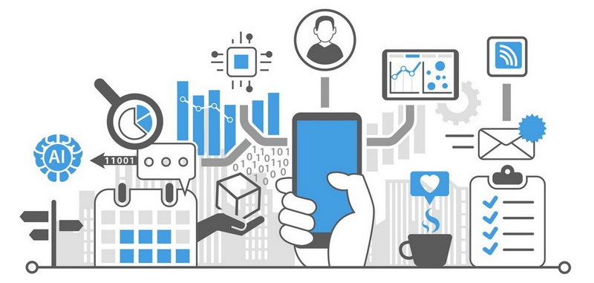
Introduction
Data at scale (big data) describes all kinds of data including
databases of numbers
images of people, things and places
footage of conversations recorded
Videos
Texts
environmentally sensed data.

Slide 3
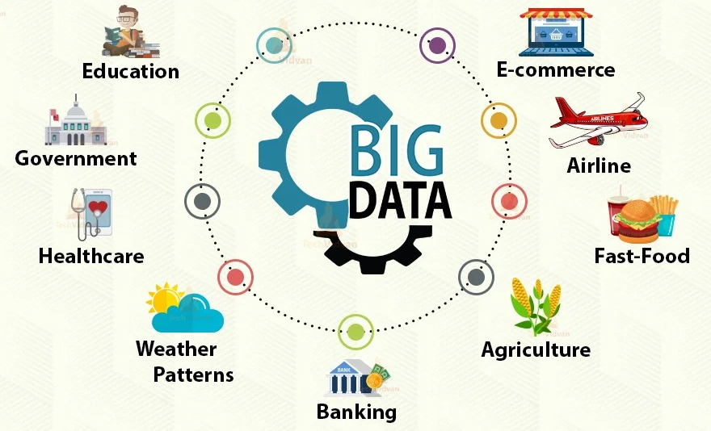
Data at Scale
Data at scale has huge potential for grounding and elucidating problems
It can be collected, used, and communicated in a wide variety of ways

Slide 4
Big Data and Issues
However, beyond societal benefits, data can also be used in potentially harmful ways
Security Issues
Data collected by multiple organization contains sensitive information which is always prone to being attacked by hackers and leaked online.
Privacy Risk
The collected information can be used for malicious activities, and lead to elimination of freedom of anonymity.
Unintentional Data Discrimination
Inaccurate big data may create an analytical biases, and unintentionally discriminate individuals based on age, race, gender and ethnicity.

Slide 5
Approaches for Collecting and Analyzing Data
Scrapping and 2nd Source Data
Collecting Personal Data
Crowdsourcing Data
Sentiment Analysis
Social Network Analysis
Combining Multiple Source of Data

Slide 6
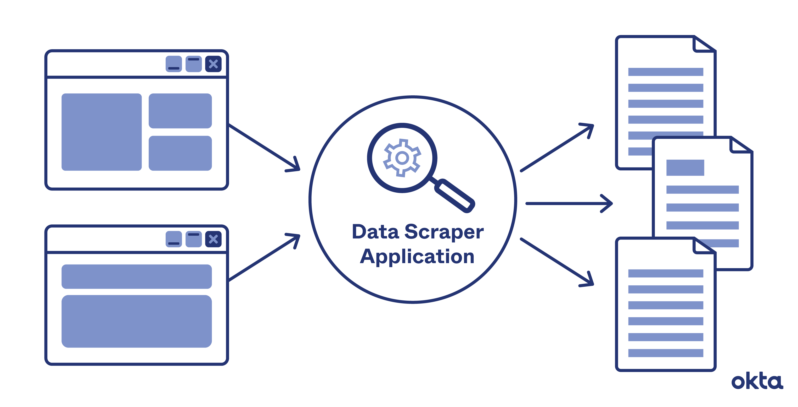
Scrapping and 2nd Source Data
Scrapping
One way to extract data is by “scraping” it from the websites (assuming that this is allowed by the application).
Once the data is scraped, it can be entered into a spreadsheet (human readable) for study and analyzed using data science tools.

Slide 7
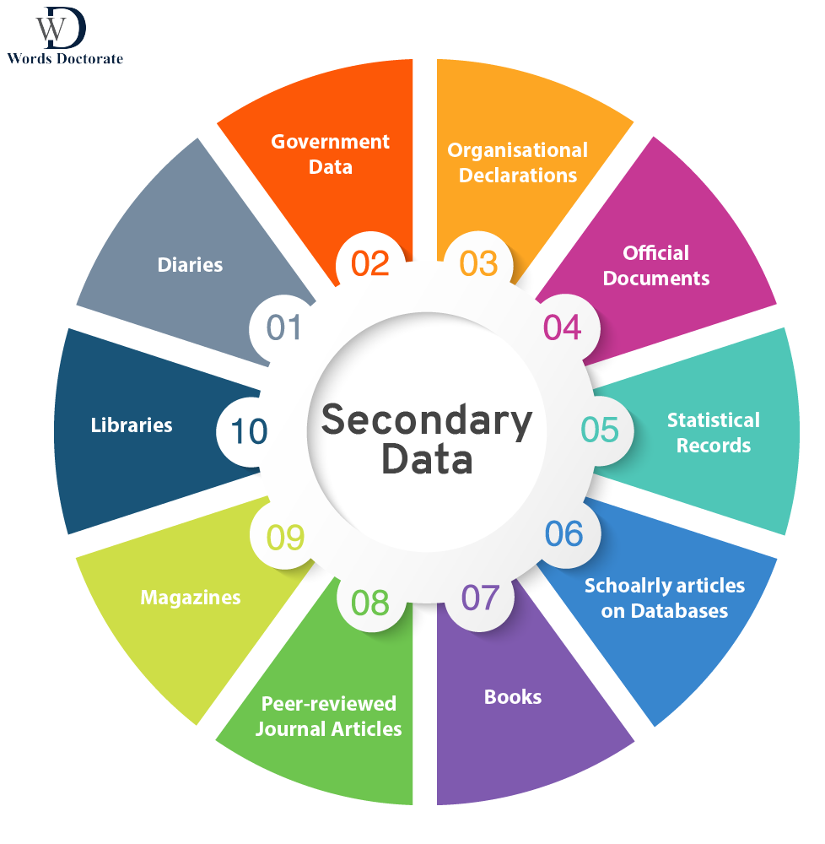
Scrapping and 2nd Source Data
Second Source
The openly available big data that Google and other companies now provide for researchers to mine offers a “second source” methodology
Search terms,
Facebook posts,
Instagram comments, and so on
Analytical Tool: Google Trend

Slide 8
Scrapping and 2nd Source Data
Analysis of this data can indirectly reveal new insights about the users’ concerns, desires, behaviors, and habits.
Important is what is done with the new available data?

Slide 9
Collecting Personal Data
Nowadays, many apps and wearable devices exist that people can buy off the shelf, which can collect all sorts of personal data and visualize it.
For example quantify health, screen time, and sleep.
Self-tracking is also increasingly being used by people who have a condition or disease as a form of self-care.

Slide 10
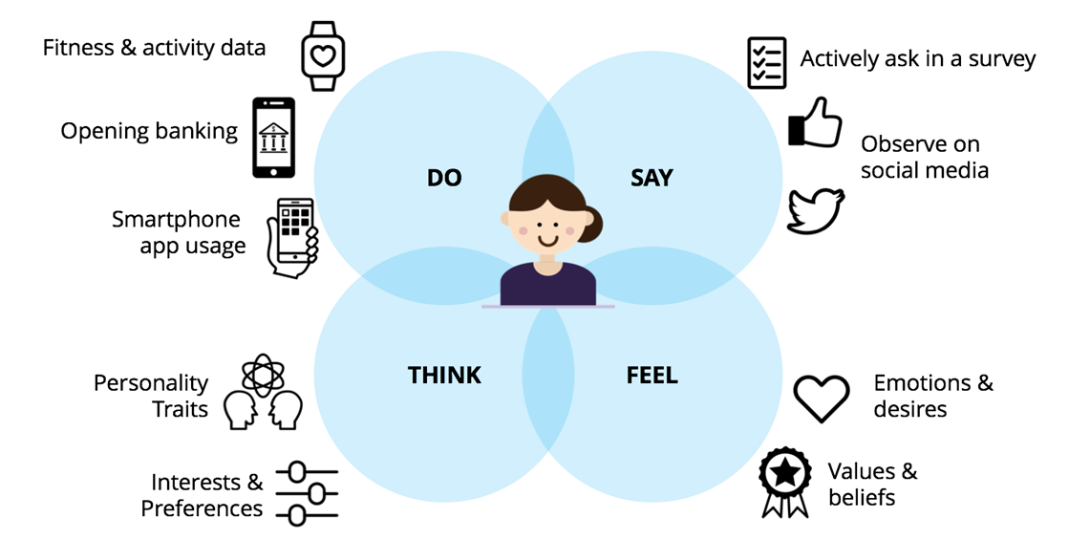
Collecting Personal Data
Quantified-self projects generate lots of data.

Slide 11
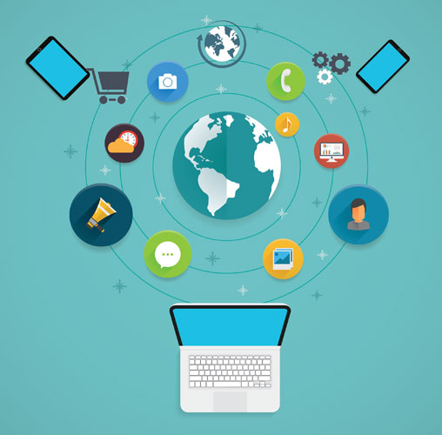
Crowdsourcing Data
People crowdsource information or work together using online technologies to collect and share data.
Crowd Research, where many researchers from all over the world come together to work on large problems.
For example climate science

Slide 12
Crowdsourcing Data
Conducting research on a massive scale enables potentially hundreds or thousands of people to work on a single project.
Examples: iSpotNature, eBird, iNaturalist and the Zooniverse.
Crowd projects raise a number of issues as to who owns and manages the data.

Slide 13
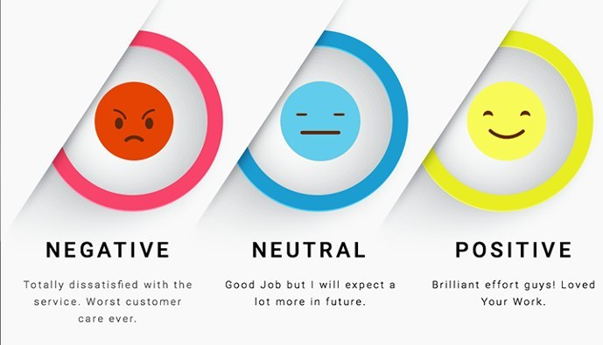
Sentiment Analysis
Sentiment analysis is a technique that is used to infer the effect of what a group of people or a crowd is feeling or saying.
The phrases that people use when offering their opinions or views are scored as being negative, positive, or neutral.
For Example
anger, sadness, or fear (negative feelings)
happiness, joy, or enthusiasm (positive feelings).

Slide 14
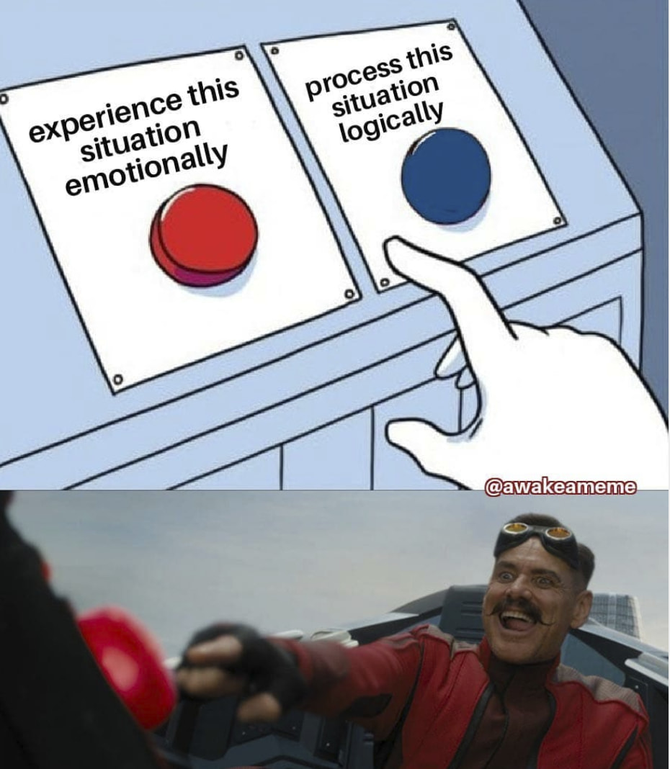
Sentiment Analysis
Sources
Tweets
Text
Online reviews
Social media
Facial expressions
Tools
DisplayR
CrowdFlower
MonkeyLearn

Slide 15
Sentiment Analysis
Sentiment analysis is commonly used by marketing and advertising companies to decide on what types of ads to design and place.
Sentiment analysis as a technique is not an exact science and should be viewed more as a heuristic than as an objective evaluation method.

Slide 16
Social Network Analysis
Social network analysis (SNA) is a method based on social network theory for analyzing and evaluating the strength of social ties within a network.
Used to understand the relationships that form among people and groups within and across different social media platforms, and with offline social networks too.

Slide 17
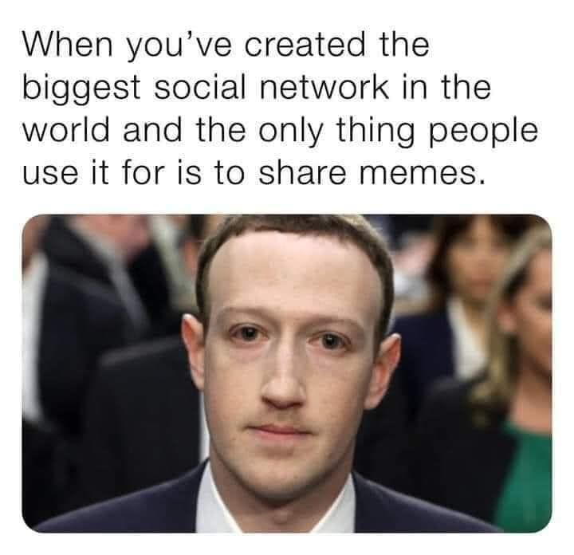
Social Network Analysis
Sources
Weibo
Tencent
Baidu
Facebook
Twitter
Instagram
YouTube.

Slide 18
Social Network Analysis
Two main entities make up a social network.
Nodes, which are also sometimes called entities or vertices, represent people and topics.
Edges are the connections between the nodes, which are also known as links or ties. The edges show the connections among nodes, for example, the members of a family.
Directional and Nondirectional Edges

Slide 19
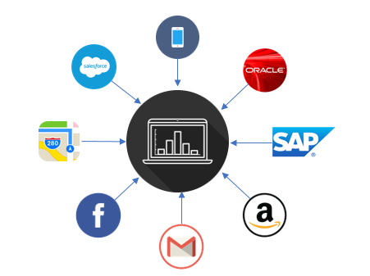
Combining Multiple Sources of Data
Collecting data from multiple sources by combining automatic sensing and subjective reporting.
The goal is to obtain a more comprehensive picture about a domain
such as a population’s mental health

Slide 20
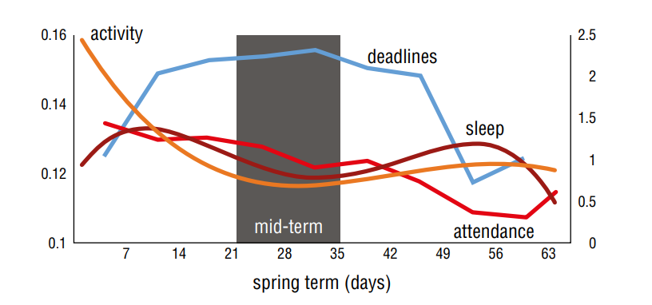
Combining Multiple Sources of Data
Example: Studentlife (Harari et al., 2017)
Student’s activity, sleep, and attendance levels against deadlines during a term Source: StudentLife Study

Slide 21
Visualizing and Exploring Data
Visualization include being able to see it and understand the way that it is represented and its context (data should be meaningful)
What kind of data is it?
What is the data about?
Why was it collected?
Why was it analyzed and represented in a particular way?
The skills needed to understand and interpret visualizations are referred to as visual literacy.

Slide 22
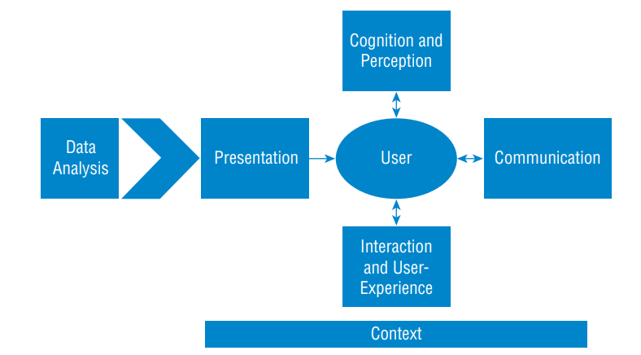
Visualizing and Exploring Data
A simplified path for data to be meaningful

Slide 23
Visualizing and Exploring Data
The goal of data visualization tools is to amplify human cognition so that users can see patterns, trends, correlations, and anomalies in the data that lead them to gain new insights and make new discoveries
Data visualization tools can help users change and manipulate variables to see what happens
“overview first, zoom and filter, and then details on demand.” Ben Shneiderman (1996)

Slide 24
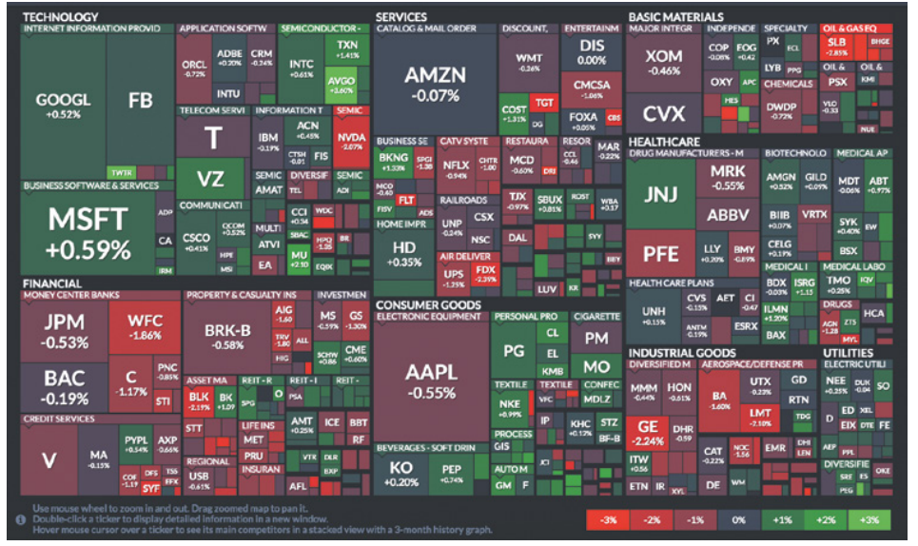
Example
A market map of the S&P 500, which is a financial index for stocks. Green indicates stocks that increased in value, and red indicates stocks that decreased in value that day.

Slide 25
Visualizing and Exploring Data - Dashboard
The dashboard is an interactive panel of control widgets that contains
Sliders
Checkboxes
Radio buttons,
and coordinated multiple window displays of different kinds of graphical representations
such as bar and line graphs, heat maps, tree maps, infographics, word clouds, scatterplots, and other kinds of visualizations.

Slide 26
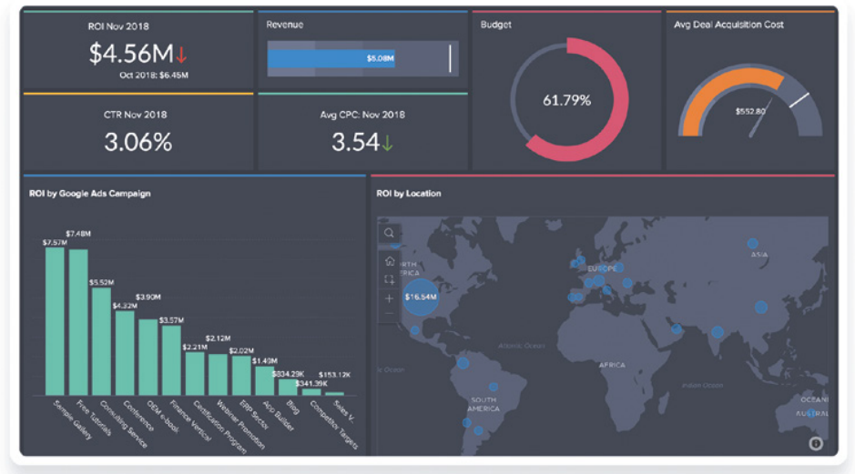
Example
A dashboard that was created to show changes in sales information.

Slide 27
Ethical Design Concerns
By “ethics,” this is usually taken to mean “the standards of conduct that distinguish between right and wrong, good and bad, and so on”
Privacy by design is a way to avoid collecting excessive data that might be sensitive but not needed

Slide 28
Data Ethics Principles
Fairness refers to impartial and just treatment or behavior without favoritism or discrimination
Accountability refers to whether an intelligent or automated system that uses AI algorithms can explain its decisions in ways that enable people to believe they are accurate and correct.
Transparency refers to the extent to which a system makes its decisions visible and how they were derived
Explainability refers to a growing expectation in HCI and AI that systems, especially those that collect data and make decisions about people, provide explanations that laypeople can understand.

Slide 29
Conclusion
Introduction
Approaches to collecting and analyzing data
Visualizing and exploring data
Ethical design concerns

